Slide 1
5G SMART DIABETES : TOWARD PERSONALIZED DIABETESDIAGNOSIS
WITH HEALTHCARE BIG DATA CLOUDS

Slide 2
2.Abstract
Recent advances in wireless networking and big data technologies, such as 5G networks, medical big data analytics, and the Internet of Things, along with recent developments in wearable computing and artificial intelligence, are enabling the development and implementation of innovative diabetes monitoring systems and applications. Due to the life-long and systematic harm suffered by diabetes patients, it is critical to design effective methods for the diagnosis and treatment of diabetes. Based on our comprehensive investigation, this article classifies those methods into Diabetes 1.0 and Diabetes 2.0, which exhibit deficiencies in terms of networking and intelligence. Thus, our goal is to design a sustainable, cost-effective, and intelligent diabetes diagnosis solution with personalized treatment.
We first propose the 5G-Smart Diabetes system, which combines the state-of-the-art technologies such as wearable 2.0, machine learning, and big data to generate comprehensive sensing and analysis for patients suffering from diabetes.

Slide 3
3.Introduction
Nearly 8.5% of the global population, totaling 422 million individuals, suffer from diabetes, with type 2 diabetes mellitus comprising approximately 90% of cases .
Alarming trends suggest an increase in diabetes among teenagers and youth , necessitating urgent improvements in prevention and treatment methods.
Existing diabetes detection systems face several challenges:
Uncomfortable and lacking real-time data collection and continuous monitoring .
Lack of a data sharing mechanism and personalized big data analysis .
Absence of continuous suggestions for prevention, treatment, and supervision strategies .
Introducing the 5G-Smart Diabetes system, a next-generation solution integrating novel technologies such as 5G mobile networks, machine learning, medical big data, social networking, and smart clothing .
The "5G" in 5G-Smart Diabetes signifies:
Utilization of 5G technology for high-quality, continuous monitoring and treatment services, ensuring patient freedom.
"5 goals" encompassing cost effectiveness, comfortability, personalization, sustainability, and smartness.

Slide 4
Introduction
Cost Effectiveness: Achieved through healthy lifestyle promotion and out-of-hospital treatment.
Comfortability: Integrated smart clothing, mobile phones, and portable monitoring devices for minimal disruption to daily activities.
Personalization: Utilized machine learning for personalized diagnosis and treatment based on individualized data.
Sustainability: Continuous data collection, analysis, and effective information sharing among stakeholders.
Smartness: Utilized cognitive intelligence for early detection, prevention, and personalized treatment.
The presentation will cover the system architecture, data sharing mechanism, personalized data analysis model, introduction of the 5G-Smart Diabetes testbed, and conclusion.

Slide 5
4.Literature Survey ( Existing Methods)
Global Status Report on Noncommunicable Diseases 2014
Provides insights into the global landscape of noncommunicable diseases, including diabetes.
IDF Diabetes Atlas, 6th ed.
Offers comprehensive data and statistics on the prevalence and impact of diabetes worldwide.
Disease Prediction by Machine Learning over Big Healthcare Data
Explores the application of machine learning techniques in predicting disease outcomes using extensive healthcare data.
Application of Adaptive Neuro-Fuzzy Inference System for Diabetes Classification and Prediction
Investigates the use of adaptive neuro-fuzzy inference systems for classifying and predicting diabetes.
Real-Time Decision Rules for Diabetes Therapy Management by Data Stream Mining
Examines real-time decision rules and data stream mining techniques for managing diabetes therapy effectively.

Slide 6
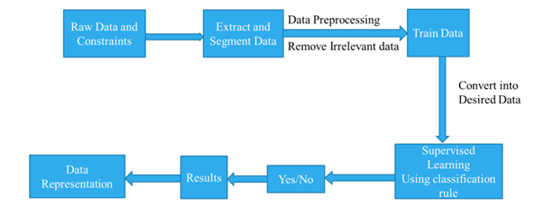
5.Proposed method

Slide 7
5.1 Overview of 5G-Smart Diabetes Architecture
Introduction:
Revolutionizing diabetes management.
Focuses on prevention and post-hospitalization treatment.
Key Components:
Sensing Layer: Collects comprehensive physiological data.
Personalized Diagnosis Layer: Utilizes machine learning for personalized analysis.
Data Sharing Layer: Facilitates efficient data sharing among patients and healthcare providers.
Advantages:
Enhanced monitoring beyond blood glucose.
Intelligent diagnosis for personalized treatment.
Efficient data sharing for better care.

Slide 8
5.2 System Architecture
Sensing Layer:
Collects blood glucose, physiological, dietary, and exercise data.
Utilizes devices like blood glucose monitors, smart clothing, and smartphones.
Personalized Diagnosis Layer:
Processes healthcare big data using machine learning.
Builds personalized models for disease analysis and prediction.
Data Sharing Layer:
Facilitates data sharing in social and data spaces.
Enables efficient communication among patients and healthcare providers.

Slide 9
5.3 Testbed Evaluation and Recommendations
Testbed Evaluation:
Demonstrates feasibility and effectiveness through machine learning algorithms.
Validates architecture with real-world data collection.
Recommendations for Prevention and Treatment:
Provides personalized diet, exercise, and social support recommendations.
Improves patient outcomes through holistic diabetes management.

Slide 10
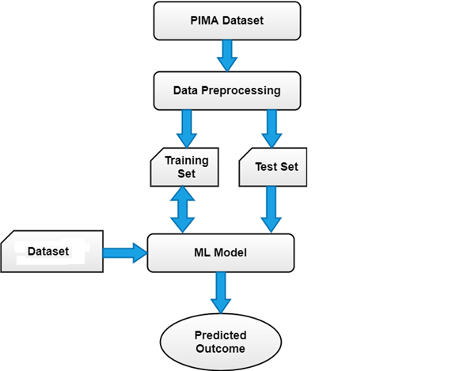
5.4 Activity Diagram

Slide 11
6.Conclusion
In this article, we first propose a 5G-Smart Diabetes system that includes a sensing layer, a personalized diagnosis layer, and a data sharing layer. Compared to Diabetes 1.0 and Diabetes 2.0, this system can achieve sustainable, cost-effective, and intelligence diabetes diagnosis. Then we propose a highly cost-efficient data sharing mechanism in social space and data space. In addition, using machine learning methods, we present a personalized data analysis model for 5G-Smart Diabetes. Finally, based on the smart clothing, smartphone and data center, we build a 5G-Smart Diabetes testbed. The experimental results show that our system can provide personalized diagnosis and treatment suggestions to patients.

Slide 12
7. References
1. S. Mendis, “Global Status Report on Noncommunicable Diseases 2014,” WHO, tech. rep.; http://www.who.int/ nmh/publications/ncd-status-report-2014/en/, accessed Jan. 2015.
2. F. Florencia et al.,IDF Diabetes Atlas, 6th ed., Int’l. Diabetes Federation, tech. rep.; http://www.diabetesatlas.org/, accessed Jan. 2016.
3. M. Chen et al., “Disease Prediction by Machine Learning over Big Healthcare Data,” IEEE Access, vol. 5, June 2017, pp. 8869--79.
4. O. Geman, I. Chiuchisan, and R. Toderean, “Application of Adaptive Neuro-Fuzzy Inference System for Diabetes Classification and prediction},” Proc. 6th IEEE Int’l. Conf. E-Health and Bioengineering, Sinaia, Romania, July 2017, pp. 639--642.
5. S. Fong, et al. “Real-Time Decision Rules for Diabetes Therapy Management by Data Stream Mining,” IT Professional, vol. 26, no. 99, June 2017, pp. 1--8.

